Slide 1
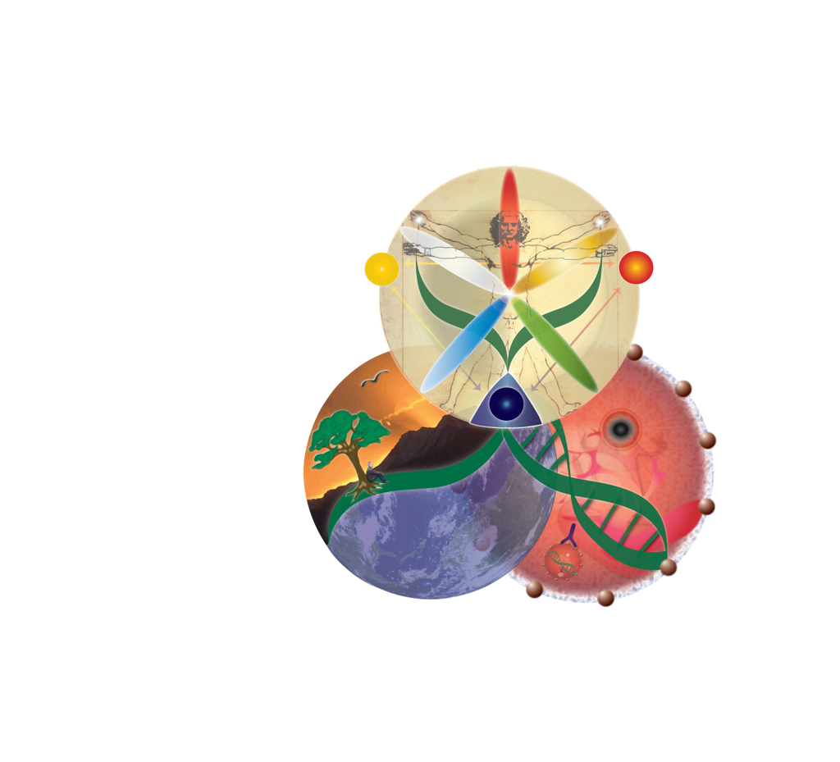
ETMS Individualized Dietary Intervention for Cancer
Constitution
& Energetics
Vital Essence, Force & Spirit;
organ systems; yin/yang,
body-type
Nutrigenomics
Dietary phytochemicals influence
on gene expression and/or molecular target pathways
Acute Effects From Cancer &/or Treatments Myelosuppression, cachexia, GI tract, kidney or liver toxicity, electrolytes, bone
Cost & Availability
Environment
Location & Time of Year
Tropical, coastal, desert, winter,
summer, spring or fall
Microenvironment Assessment
Blood test, urine
rheology, hormones etc.
Traditional Diet
Ancestry, ethnic background,
taste preferences
religious influence:
vegetarian
Nutrient Deficiencies

